Slide 1
COMS E6998: Microservices and Cloud Applications Lecture 1: Introduction
Dr. Donald F. Ferguson
dff9@columbia.edu

Slide 2
Contents

Slide 3
Contents
Introduction
A bit about your instructor.
Coursework and grading.
Logistics.
Course Overview and Contents
Schedule and topics.
Cloud
Microservices
Cloud applications.
An example “microservice, cloud application”
Demo.
Overall structure.
1st Assignment

Slide 4
Introduction

Slide 5
Your Instructor

Slide 6
A Little About Me
Columbia through and through
BA (Columbia College) ‘82, M.S. ’84 (Engineering), M.Phil. ‘84 (GSAS).
Ph.D. ‘87 (GSAS) – Thesis: “The Application of Microeconomics to the Design of Resource Allocation and Control Algorithms.”
Adjunct Professor at Columbia Univ: 2006, 2009, 2014-2017. 7 “Topics in CS” courses.
32 years of technology contribution and leadership.
VP, IBM Fellow: IBM Research, IBM Software Group.
Microsoft Technical Fellow.
Distinguished Engineer, CTO, Executive VP, CA technologies.
VP, Sr. Fellow, CTO, Dell Software Group.
Co-Founder, CTO Seeka TV (www.seeka.tv).
Personal
Two fantastic daughters; high school and one is a senior at Barnard.
Black belt in Kenpo Karate (http://www.tracyskarateworldwide.com/about.html, www.elitedefensivetactics.com )
2LT in New York Guard (http://dmna.ny.gov/nyg/)
Conversational Spanish, learning Arabic
Hobbies: Bicycling, Astronomy

Slide 7
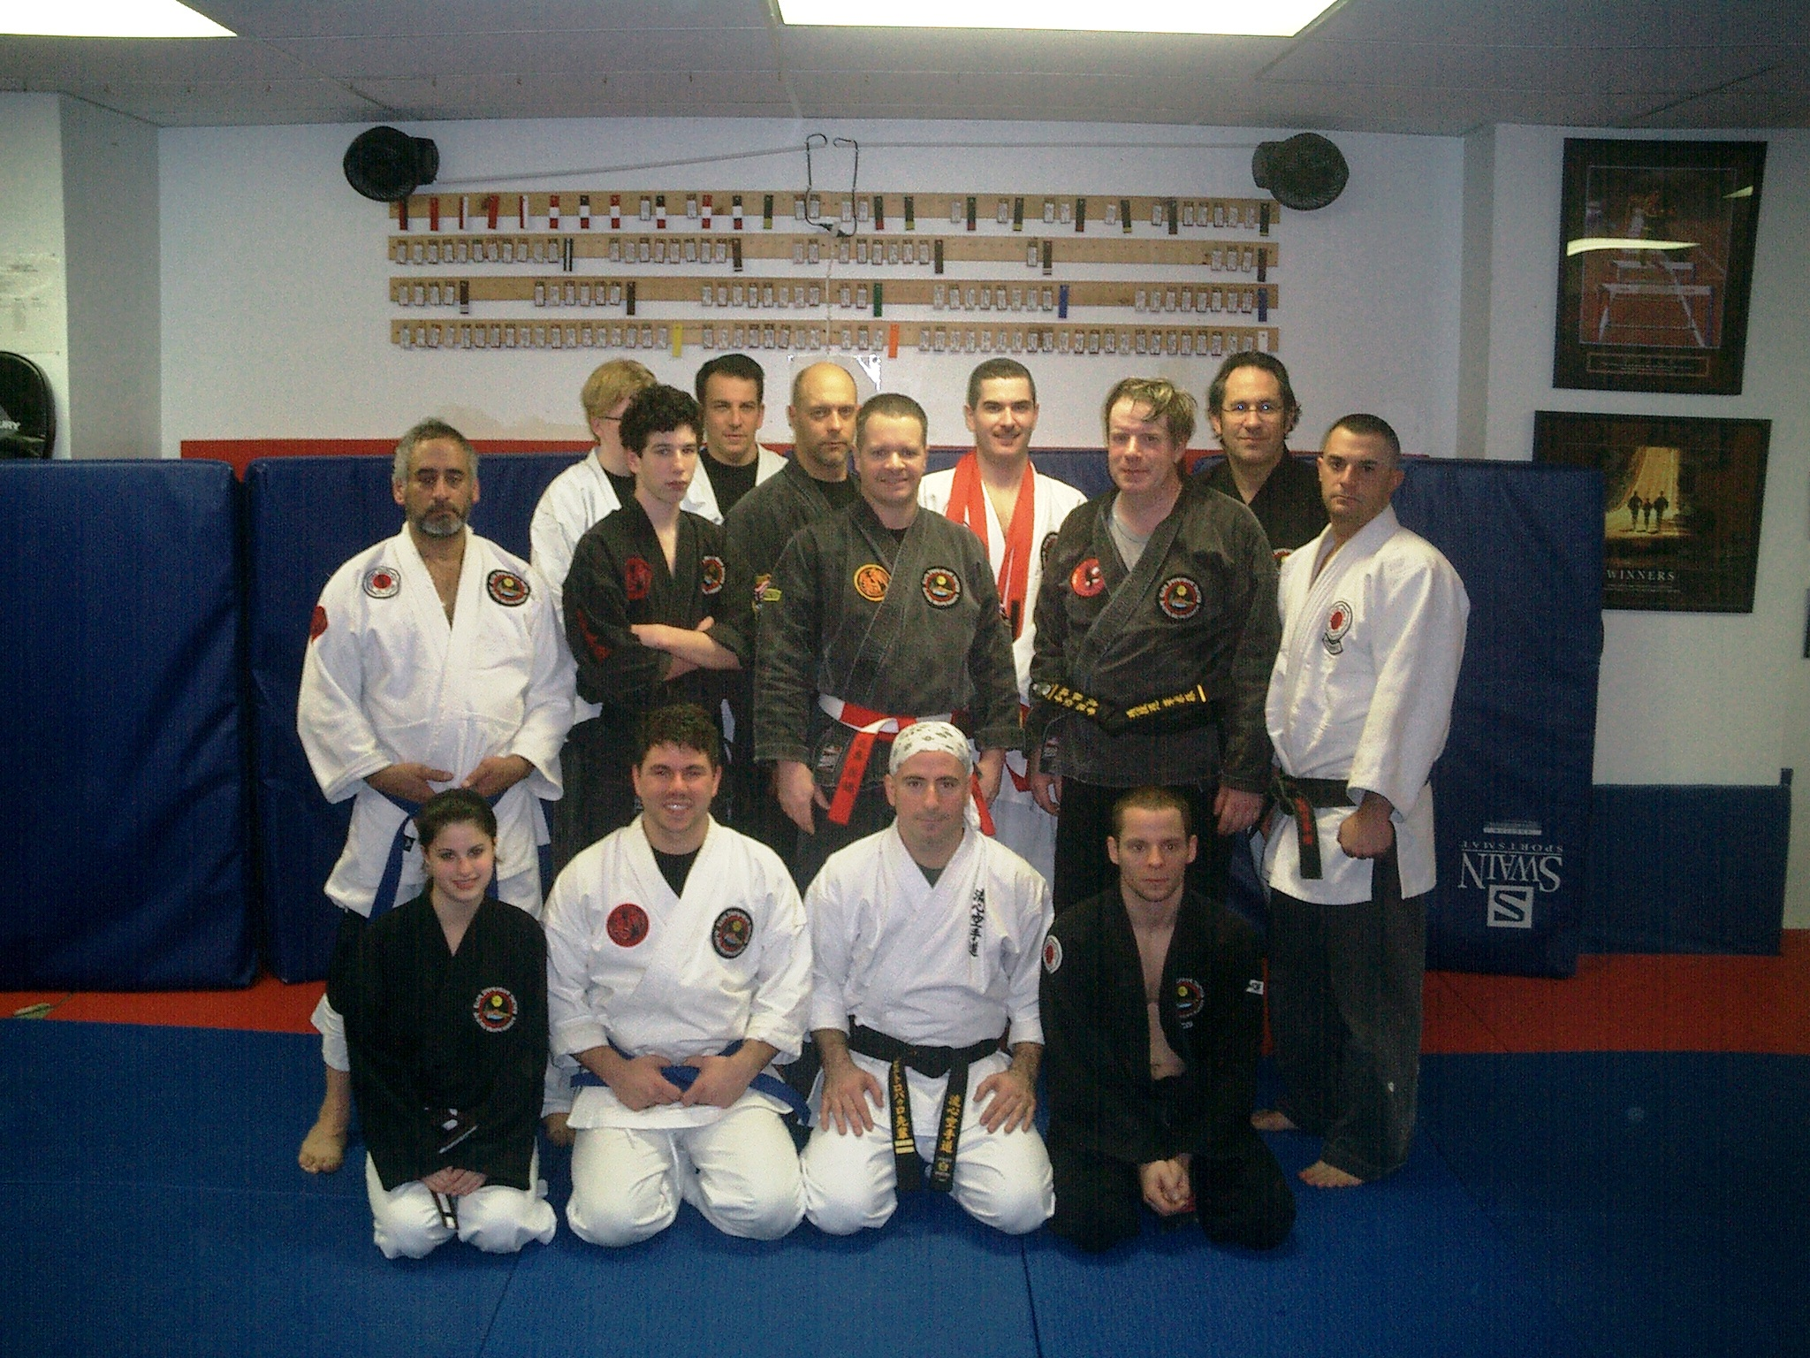
A Little About Me
Columbia through and through
BA (Columbia College) ‘82, M.S. ’84 (Engineering), M.Phil. ‘84 (GSAS).
Ph.D. ‘87 (GSAS) – Thesis: “The Application of Microeconomics to the Design of Resource Allocation and Control Algorithms.”
32 years of technology contribution and leadership.
IBM Fellow: IBM Research, IBM Software Group.
Microsoft Technical Fellow.
Distinguished Engineer, CTO, Executive VP, CA technologies.
Sr. Fellow, CTO, Dell Software Group.
Co-Found, CTO Seeka TV.
Personal
Two daughters
Black belt in Kenpo Karate
2LT in New York Guard (http://dmna.ny.gov/nyg/)
Conversation Spanish, learning Arabic
Hobbies: Bicycling, Astronomy

Slide 8
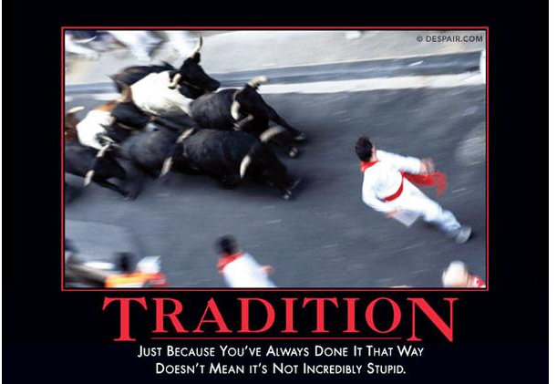
A Lot of Experience

Slide 9
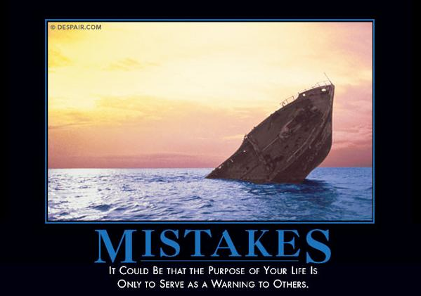
A Lot of Experience

Slide 10
A Lot of Experience
I may not be able to teach you the right way to do something,
but I can show you plenty of wrong ways to avoid.

Slide 11
Coursework Grading

Slide 12
Coursework and Grading
No midterm, final or exams.
Five 20 point projects, each of which extends previous projects.
Approximately every two weeks, with two weeks to complete.
Teams
Approximately 5 team members.
Each team has a designated primary contact and team name.
Each project has the following sub-deliverables, packaged in a zip file with a readme.
A set of user stories.
A short, simple architecture/design description with diagrams.
Demo
Application artefacts, e.g. code, DB schema/data, HTML, URL for testing, …
There will be a simulated “project review,” which is a meeting with presentation, demo, Q&A, etc.
In addition to the technology, I am trying to mentor you to learn how to be a successful technical professional. You will experience very basic concepts in
Product management.
Presentation and documentation skills.
Transforming vague requirements into something clear and implementable.
Q&A and discussion of alternatives.
Teamwork and team dynamics.
This will drive you crazy in the beginning.

Slide 13
Logistics

Slide 14
Logistics
Course material
No textbooks. Technology changes too quickly, and we will cover concepts and technologies from several disciplines.
Lecture and lecture notes will provide links to online information.
Web search is your first and best resource.
CAs:
We have two excellent CAs, with whom I have previous worked.
Will introduce themselves via email, Piazza and other collaboration environments.
Office hours
Professor: Tu/Th 10:15 to 12:00, or by appt (typically Google Hangout).
CAs: TBA
Collaboration environments:
CourseWorks for submitting projects.
Piazza: Slides, discussion (piazza.com/columbia/fall2017/comse6998_014_2017_3topicsincomputerscience)
Slack: Good way to have short discussions, get ahold of me, instant messages, etc.
Team: (https://join.slack.com/t/dff-columbia/shared_invite/MjM1MjA5NjAwOTk2LTE1MDQyODExOTQtNzEzM2FjZmMzMw).
Join channel #e6998-2017
We will use Amazon Web Services, but the concepts are general.
Questions and discussion are expected, appreciated and essential.

Slide 15
Course Overview and Content

Slide 16
Course Overview

Slide 17
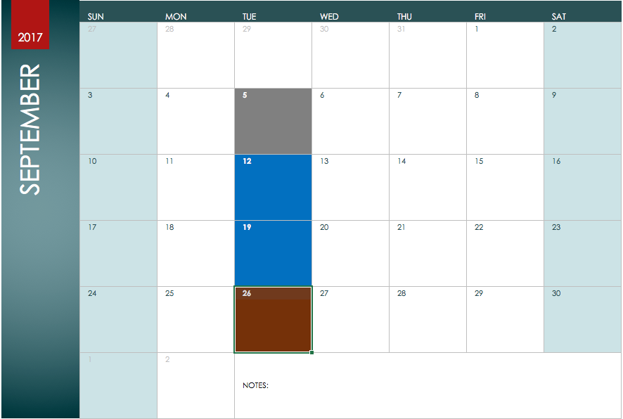
Course Overview
Core Concepts
Fundamentals
REST
Multi-Tenant
Middleware
Session
Oauth 2.0
Basic Security

Slide 18
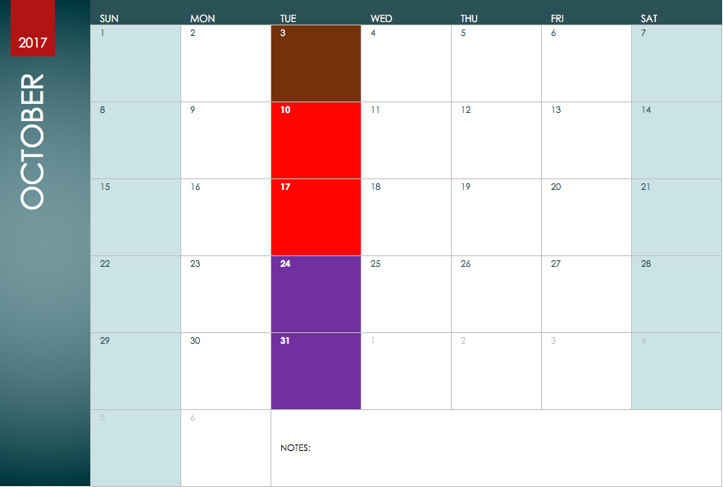
Calling Cloud APIs
Integration Patterns
Pub/Sub
Message Queues
Serverless
API Gateway
Dynamo DB
Neo4J
Redis
Data Pipeline
Step Functions

Slide 19
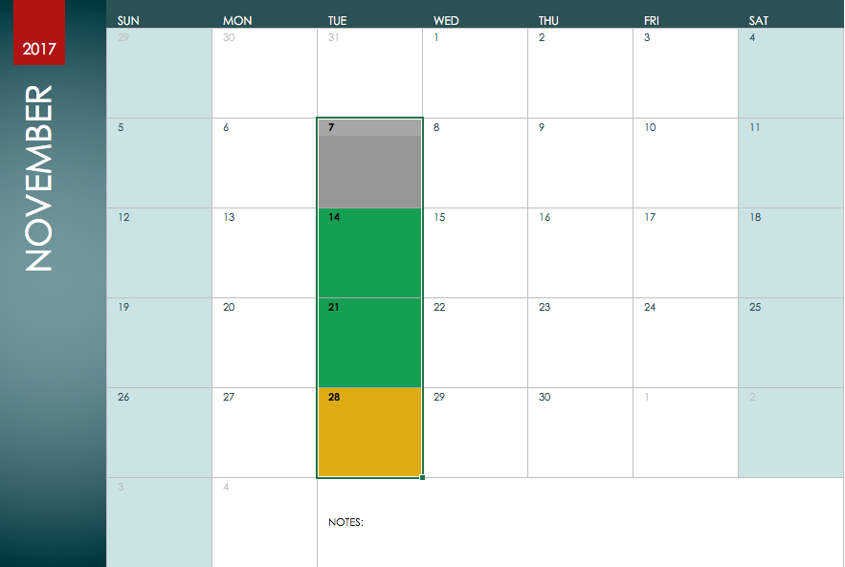
School holiday.
Web Hooks
XMPP/Chat
Rules Engine
Text
Search

Slide 20
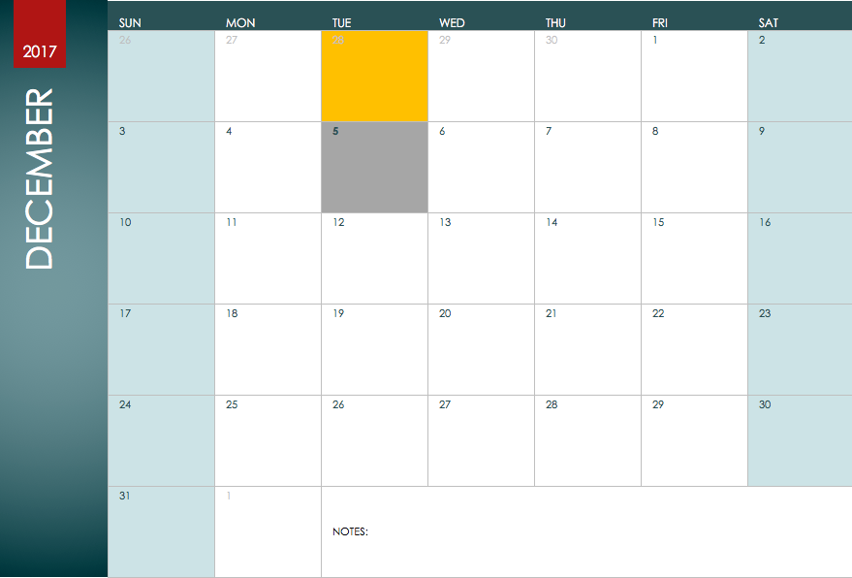
Overflow
Discussion

Slide 21
Comments
This course is about building applications
That apply best practices and design patterns,
Using a broad set of technologies,
Each of which is several lectures or a complete course unto itself.
We will cover the essentials but not the depth of the individual technologies.
One place where we will ”go deep” is on the basic structure of a well-designed application/set of microservices. Some example topics are
Model-View-Controller.
Application Tier-Data Tier.
Encapsulation/Abstraction.
REST API
My experience from prior courses has been that I have gone through these topics too quickly, causing students to do advanced topics with a poor design.

Slide 22
Course Content: Cloud Microservices Applications

Slide 23
Cloud

Slide 24
IaaS, PaaS, SaaS

Slide 25
IaaS, PaaS, SaaS
Focus will be on building
Microservices.
Cloud applications.
Using
Application containers.
Middleware and MW APIs.
SaaS APIs
And less on building containers (e.g. Docker) and lower layer infrastructure (e.g. Kubernetes)

Slide 26
IaaS, PaaS, SaaS – A Little More about PaaS

Slide 27
IaaS, PaaS, SaaS – A Little More about PaaS
Additionally
Pub/Sub
Several data service models
Web callable services, e.g. FB
Rules engine
Design patterns
… … TBD.

Slide 28
Cloud is about *- as-a-Service (https://en.wikipedia.org/wiki/As_a_service)
“*aaS is an acronym for as a service, and refers to something being made available over the Internet to a customer as a service.^{[1]} Examples include:”
Like any list, this is an overview and
Incomplete, e.g.
Business-APIs-as-a-Service: Payments is an example, but there are others, e.g.
Order Management, Inventory, Shipping, …
Calendar and events. Contact management.
Human Resources.
Information-as-a-Service
Demographics.
Credit history and information.
Market data, prices, etc.
Overly simplistic, e.g.
IaaS is many types of compute, storage, networking, ...
There are many, many types of PaaS
Integration-Platform-as-a-Service
More classical app/container, e.g. Cloud Foundry
Force.com and high-level component assembly.

Slide 29
Cloudscape
Our applications will
Call APIs
Use and run in PaaS

Slide 30
www.programmableweb.com (Example)
Over 16,000 APIs

Slide 31
Microservices

Slide 32
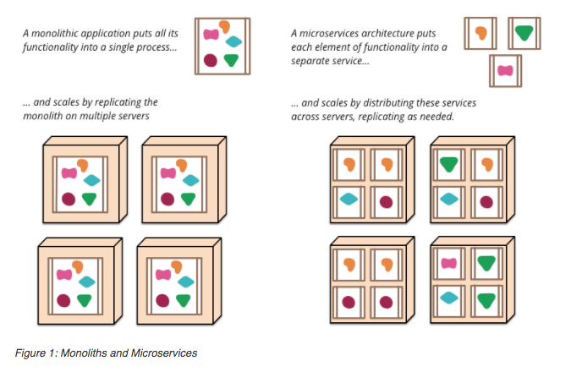
Microservices (https://martinfowler.com/articles/microservices.html)

Slide 33
Web Application Basic Concepts

Slide 34
“Traditional” Web Application Architecture

Slide 35
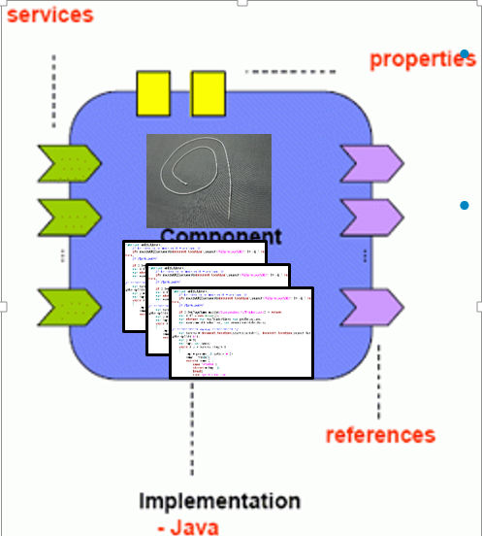
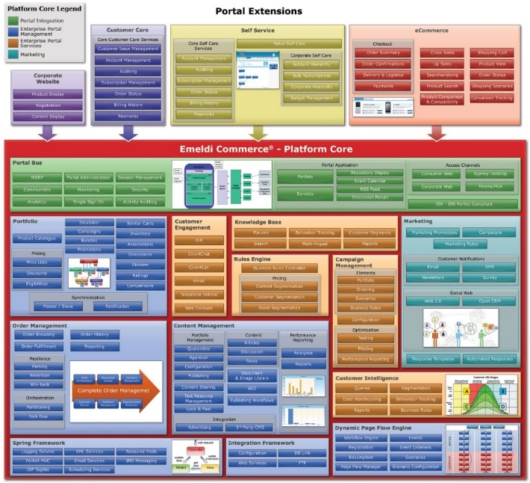
Monolithic to Micro
Cart Functions
Java
SQLite
Recommendation Functions
Node.js
Redis
Catalog Functions
PHP
MongoDB
XXX XXX
MMM
NNN
Motivations
Enable best tools, languages, … for function.
Simplifies change management and evolution.
Better alignment of apps with business functions.
Reuse of code and internet services.
Content Functions
Ruby
Amazon S3

Slide 36
Micro-services Characteristics
Componentization via Services
Organized around Business Capabilities
Products not Projects
Smart endpoints and dumb pipes
Decentralized Governance
Decentralized Data Management
Infrastructure Automation
Design for failure
Evolutionary Design

Slide 37
SOA vs Microservices
http://usblogs.pwc.com/emerging-technology/agile-coding-in-enterprise-it-code-small-and-local/

Slide 38
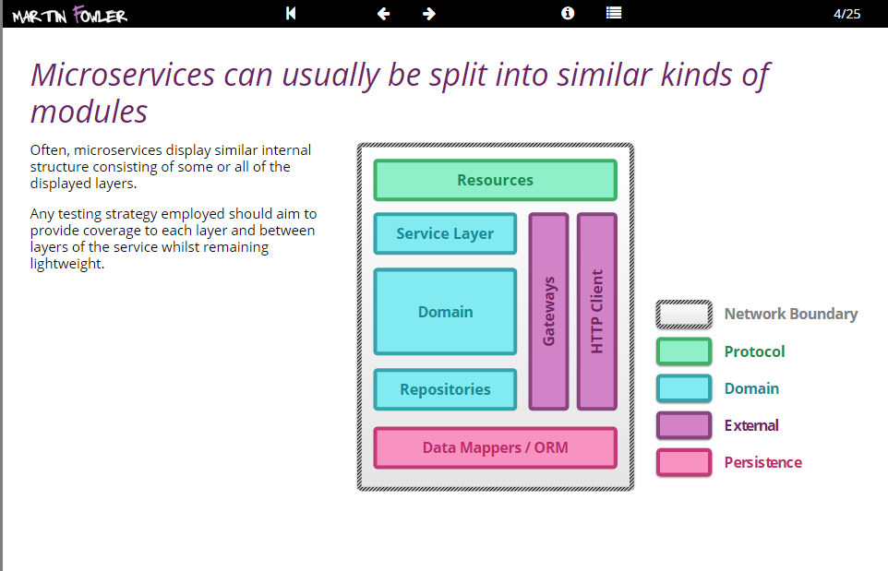
Reusable
infrastructure
containers
Inject application
implementation into
reusable SW containers
Reusable SW
containers but with
core technology
and frameworks

Slide 39
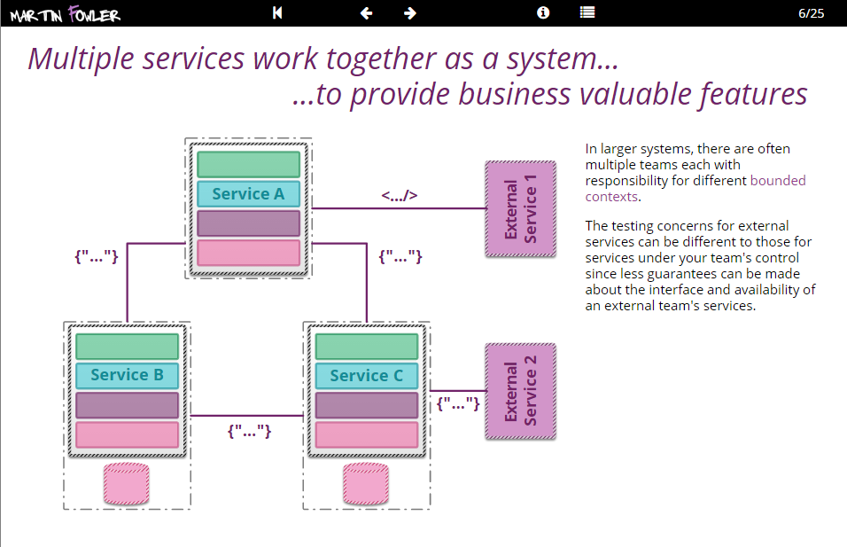

Slide 40
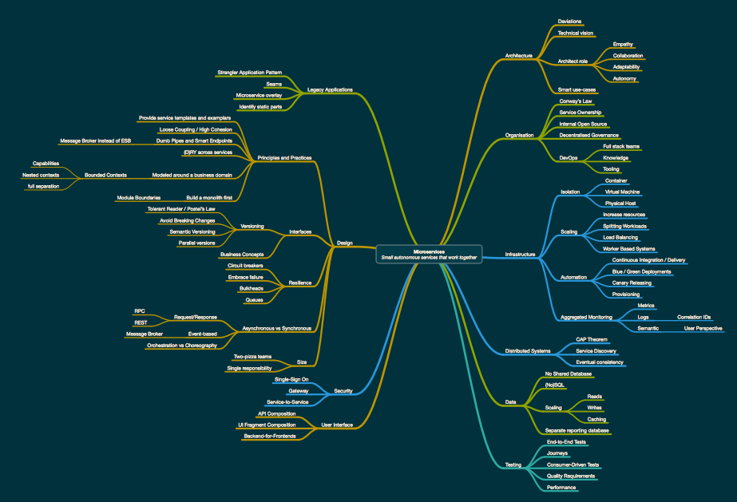
Patterns

Slide 41
Patterns
Patterns and practices are essential
PaaS and advanced infrastructure eliminate the need to worry about a lot of things, but …
No infrastructure is smart enough to make a poorly designed application flexible, scalable, available, …

Slide 42
Weinberg’s Second Law
“If builders built buildings the way programmers wrote programs, then the first woodpecker that came along would destroy civilization.”

Slide 43
An Example

Slide 44
Seeka Demo

Slide 45




(Some) Elements
User Service
Profile Service
Social Media Connector
API Gateway
Commenting Service
Payment Service
Reporting Service
Search Service
Content Catalog
Cache Service
SNS
Watch Party Service
XMPP

Slide 46
0th Project

Slide 47
0th Project
Teams
Form your teams (approx. 5 people)
Identify contact focal point.
Give your team a “cool” name.
Signup (reuse) and Amazon Web Service Account
Free Tier should be fine.
Provide access to team members.
Create an Elastic Beanstalk instance/application.
Use one of the sample application.
Will have to make more sophisticated starting next week; I will use Node JS with Express for Elastic Beanstalk examples.

